Slide 1
Pipelining
(based on slides by Patricia Brenztejn, Univ. of Buenos Aires)

Slide 2
Overview
We will discuss as an example a summation of two 128-bit numbers
We will look at three solutions:
  simple (combinational)
  sequential
  pipelined
We will analyze the advantages and disadvantages of each

Slide 3
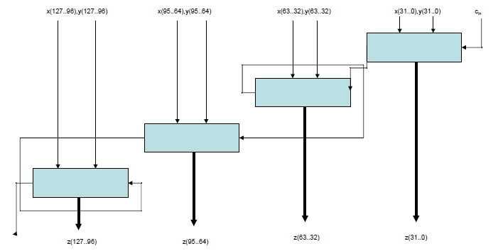
Combinational summation

Slide 4
Cost and Time of Combinational summation
Cost is simply four 32-bit adders and four 32-bit registers at the output if we want to register the result (and we probably do)
Latency is 4 times the delay of a 32 bit adder plus one T_{FF}
We can reduce the overall latency by using lookahead logic, but that will increase the logic cost. We won’t do this here in order to have a good comparison with the other architectures.

Slide 5
Combinational Summation: Cost in resources (C) and cost in Time (T)
The cost in logic is (assuming output register):
C=128C_{FF}+4C_{adder}(32)
The cost in time (time per result, or 1/throughput, in this case equal to the minimum clock period) is:
T_{min}>T_{FF}+4*T_{adder}(32)
Note that T_{FF} is defined as the summation of both setup time and clk-to-q delay of the flip-flops

Slide 6
Sequential Summation (not pipelining)
Suppose that we want to implement a 128-bit adder using a 32-bit summer.
This is a sequential implementation, i.e. we will reuse the 32-bit adder four times in order to get the 128-bit sum
Though it may not make sense to do this for addition, this is an example of reusing a resource in the chip to save logic area, at the expense of latency. This is done a lot for more complicated blocks (e.g. FFT).
To determine the number of clock cycles necessary we can make a flow diagram.

Slide 7
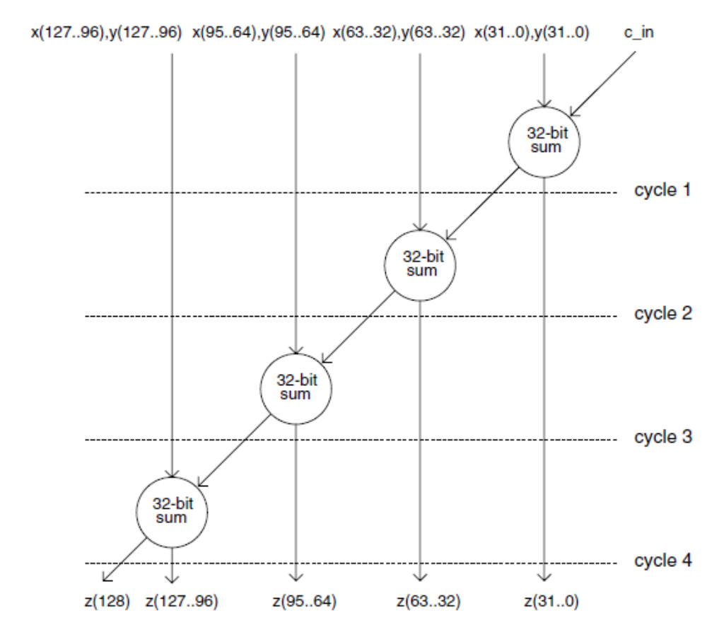
Sequential Addition

Slide 8
Sequential Addition: Resources
We will need four 32-bit registers in order to store the result of each cycle, and another flip-flop for the carry out.
It will take at least 4 clock cycles to complete a 128-bit sum

Slide 9
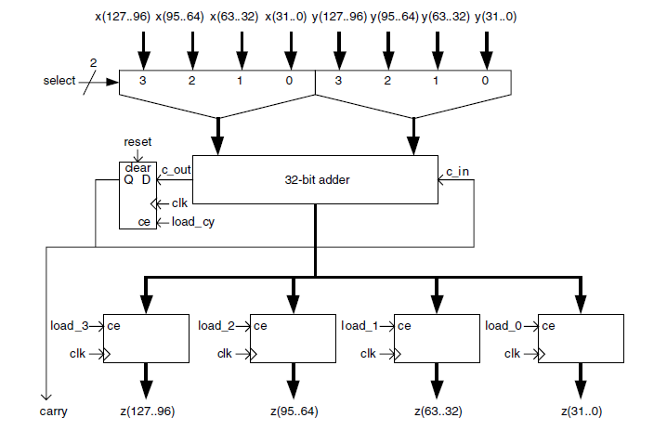
Sequential addition: Implementation

Slide 10
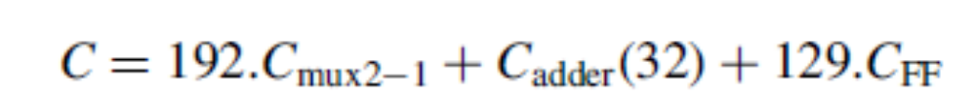
Sequential Addition: Cost in resources (C) and cost in Time (T)
Cost in resources can be show to be:
Cost in time (time per result, or 1/throughput) can be shown to be:

Slide 11
Necessity of control FSM
To implement the sequential addition, we need to have a state machine that will manipulate the control signals in the sequential adder circuit.
The state machine will be easy to visualize (simple linear flowchart) but this is only true in relatively simple cases such as this adder
The FSM incurs an additional (small) resource cost and potentially an additional small delay as well (usually of one or two cycles)

Slide 12
Implementation via Pipeline
We talked about pipelining earlier
Basically the idea is to separate the operation into smaller parts that can operate faster than the whole design
In this case, for a fair comparison let’s separate into 4 pipeline stages, each of which will sum 32 bits
As we saw in an earlier lecture, dividing the operation into parts of equal latency gets the best improvement.

Slide 13
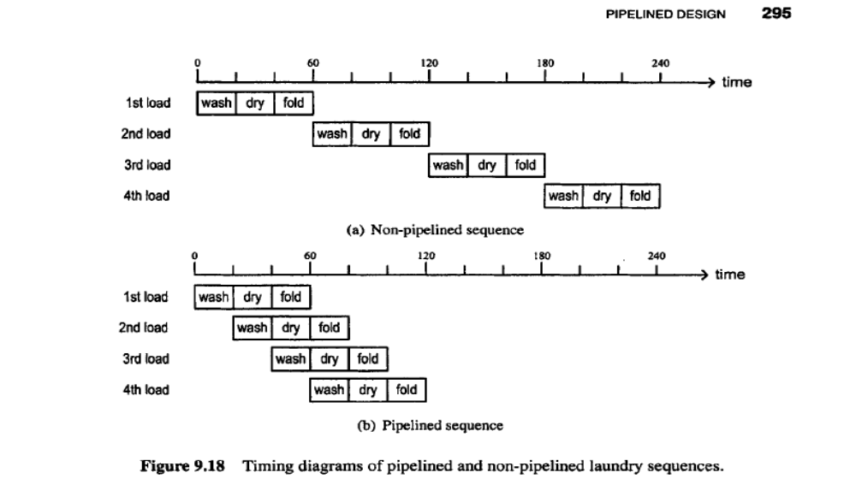
Reminder: the basic idea

Slide 14
Productivity of Non-Pipelined Washing/Drying/Folding Algorithm
If each step takes 20 minutes, then the three steps in sequence take 60 minutes,
Therefore the throughput is 1 load every 60 minutes or 1/60 loads/minute

Slide 15
Productivity of Pipelined Washing/Drying/Folding Algorithm
If we process k loads, then this will take 40+20k minutes.
The productivity will therefore be k/(40+20k) loads/minute.
Assume that k is large (nearly always the case in hardware, since we process a lot of data), then in the limit the productivity is 1/20, or 3 times higher than that of the non-pipelined solution, as expected
In general the ideal speedup is M times the non-pipelined speed, where M is the number of stages, if the non-pipelined logic can be divided into M equal-latency parts. For the washing/drying/folding example, M=3. For the 128-bit adder, M=4.

Slide 16
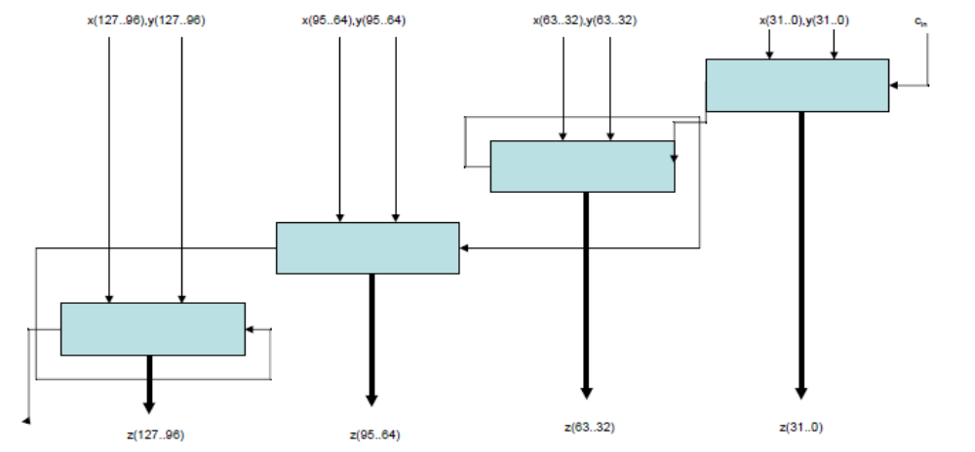
Implementation of the Pipelined Solution
Let’s start off from the combinational version:

Slide 17
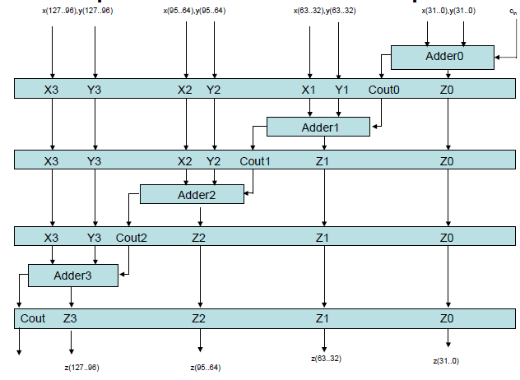
Let’s add pipeline registers…

Slide 18
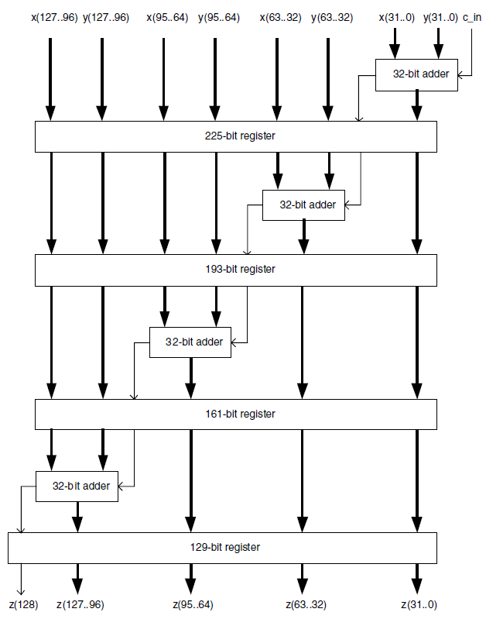
Notice the register widths:

Slide 19
Cost in Time and Logic for Pipeline Solution
The cost in logic is :
C=708C_{FF}+4C_{adder}(32)
The cost in time (minimum clock period, 1/throughput) is:
T_{min}>T_{FF}+T_{adder}(32)
Note the huge increase in FFs, and the big speedup, both as expected

Slide 20
Comparison/Conclusions
Sequential implementation used the least adders. If this were a very complicated function (e.g. FFT), this may have been a very big advantage. However it had the longest latency.
Combinational implementation (+ output flip-flops) used a low amount of resources, but long latency rivaling that of the sequential solution.
Pipelining solution was much faster but required a lot more flip-flops.
Conclusion: if we want to do something really fast, pipelining is a good option, but we must have the necessary logic resources.

Slide 21
Pipelining In-Class Activity
In the In-Class Activity we will do exactly what we talked about in this lecture
We will construct a 128-bit adder, first combinationally and then using pipelining
We will use timing analyzer to analyze and compare the results
We will thus get practice in actual pipeline design and we will observe first-hand the speedup achievable.

